Slide 1
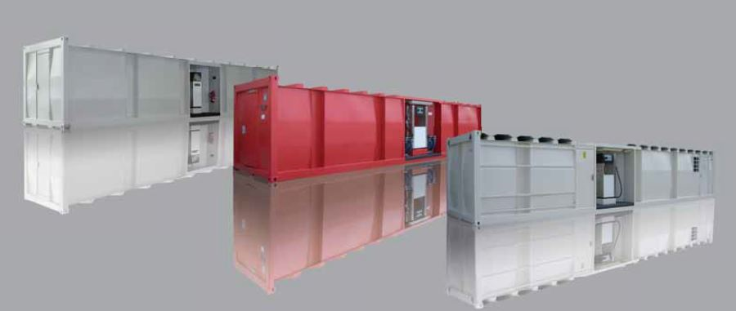
THE AUTOMATED FUEL RETAIL OUTLETS PROJECT
The Future Of Fuel Retail Now

Slide 2
CONFIDENTIALITY
This proposal has been presented to you on a confidential basis for your information and consideration ONLY.
By reading it, you agree not to disseminate it to any other person or entity in any manner and not to use the information for any purpose other than considering opportunities for a cooperative business relationship with KARPOS LOGISTICS LTD.
This proposal and its contents is the property of KARPOS LOGISTICS LTD . No part of this document, including all original concepts and ideas contained herein, may be reproduced or transmitted in any form, or by any means, electronic or mechanical, for any purpose without the express written permission of KARPOS LOGISTICS LTD.
If you wish to use any of the original concepts and ideas provided by KARPOS LOGISTICS LTD herein, you will first offer to engage KARPOS LOGISTICS LTD to execute the applicable proposal on commercially reasonable terms before offering the project to any other third party.

Slide 3
INTRODUCTION
Cloritus International Concepts Ltd is a supplier of high quality and secure fuel storage and delivery systems for fuel retail and distribution.
Our Automated Fuel Retail Outlets or A.F.R.O Stations are manufactured to meet the very strict efficiency, durability, safety and environmentally friendly standards within the industry, thus making them second to none.
Our customers have so far found our products to be a useful and advantageous solution to boost their operations and also be a vehicle to further increase their market share.
We encourage you to contact us via cloritus@gmail.com for more information about our product offers.

Slide 4
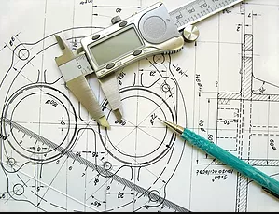
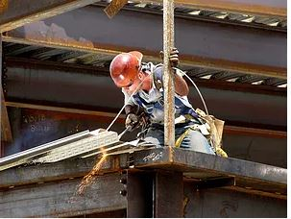
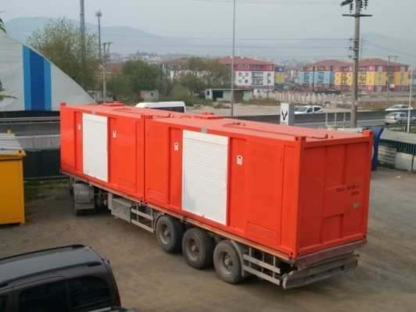
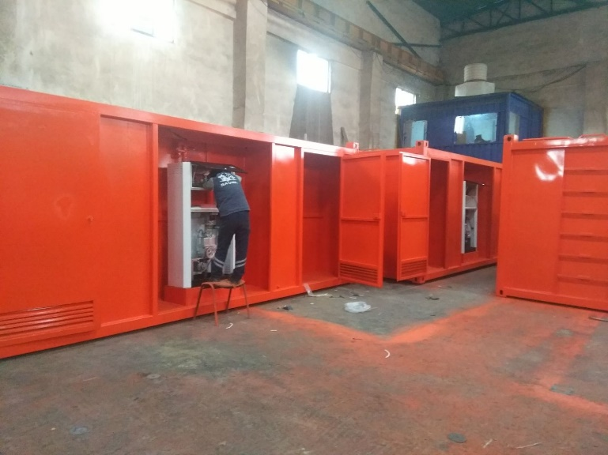
OUR SERVICES
Design and Planning
Fabrication & Building
Delivery and Installation
Service & Maintenance

Slide 5
PROJECT BACKGROUND
The Automated Fuel Station Project is an initiative born out of the vision of our company to ensure constant fuel supply by deploying technologically advanced solutions to the fuel retail industry.
Our A.F.R.O Stations are 24hr retail outlets that can also use the Automated Dispenser Pumps and Fuel Cards for their operations. These retail outlets are useful in serving customers within busy, developed and urbanized communities.
The purpose of this project is to present the equipment, technology, outline the advantages, safety operations and to create an excellent means of market territory expansion for any Oil Marketing Company willing to engage our company to deploy the AFR’s in the market.

Slide 6
SOLUTION FEATURES
The Characteristics of our Automated Fuel Retail Outlets(AFRO) Stations:
Modern equipment
Safe delivery system to clients
No environmental degradation risk
Regulated operations within a highly competitive industry
Economical and Quick Deployment Assured

Slide 7
OPPORTUNITY
This project is not merely the solution to address the challenges mentioned but also assures immense Economic and Environmental benefits in addition to the highly lucrative business venture for NNPC in business with Cloritus International Concepts Ltd.
The opportunity to create wealth by providing sustainable solutions to our customers is the drive and guarantee for our success as a business.

Slide 8
ECONOMIC BENEFITS
EMPLOYMENT OPPORTUNITIES
The deployment of the A.F.R.O Stations to operate on 24-hour basis will create jobs will require security service at night and trained maintenance and support service personnel.
GOVERNMENT REVENUES
The deployment of the A.F.R.O Stations to operate on 24-hour basis will enable the industry regulators to generate more revenue through increased fuel sales.
SAVINGS BENEFITS
The adaption of the A.F.R.O Stations will give you, our client (NNPC) significant savings on initial set up costs as compared to the cost of building traditional filling stations.

Slide 9
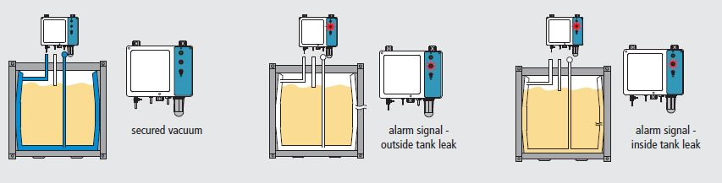
ENVIRONMENTAL BENEFITS
SAFETY AND SECURITY
The delivery system of the A.F.R.O Stations will greatly reduce the risk of the occurrence of any disaster as compared to the current system being used.
The A.F.R.O Stations are a safer and secure as well as environmentally friendlier delivery system.

Slide 10
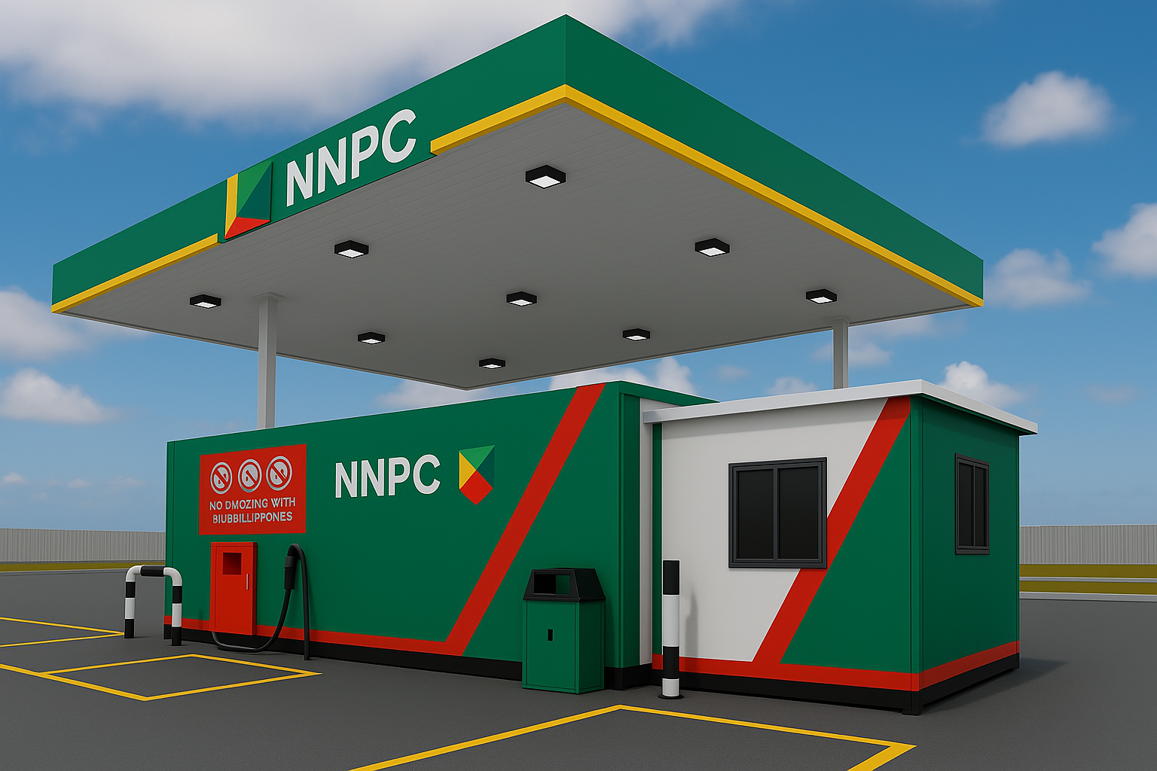
PROPOSED STATION MODEL DESIGN 1A

Slide 11
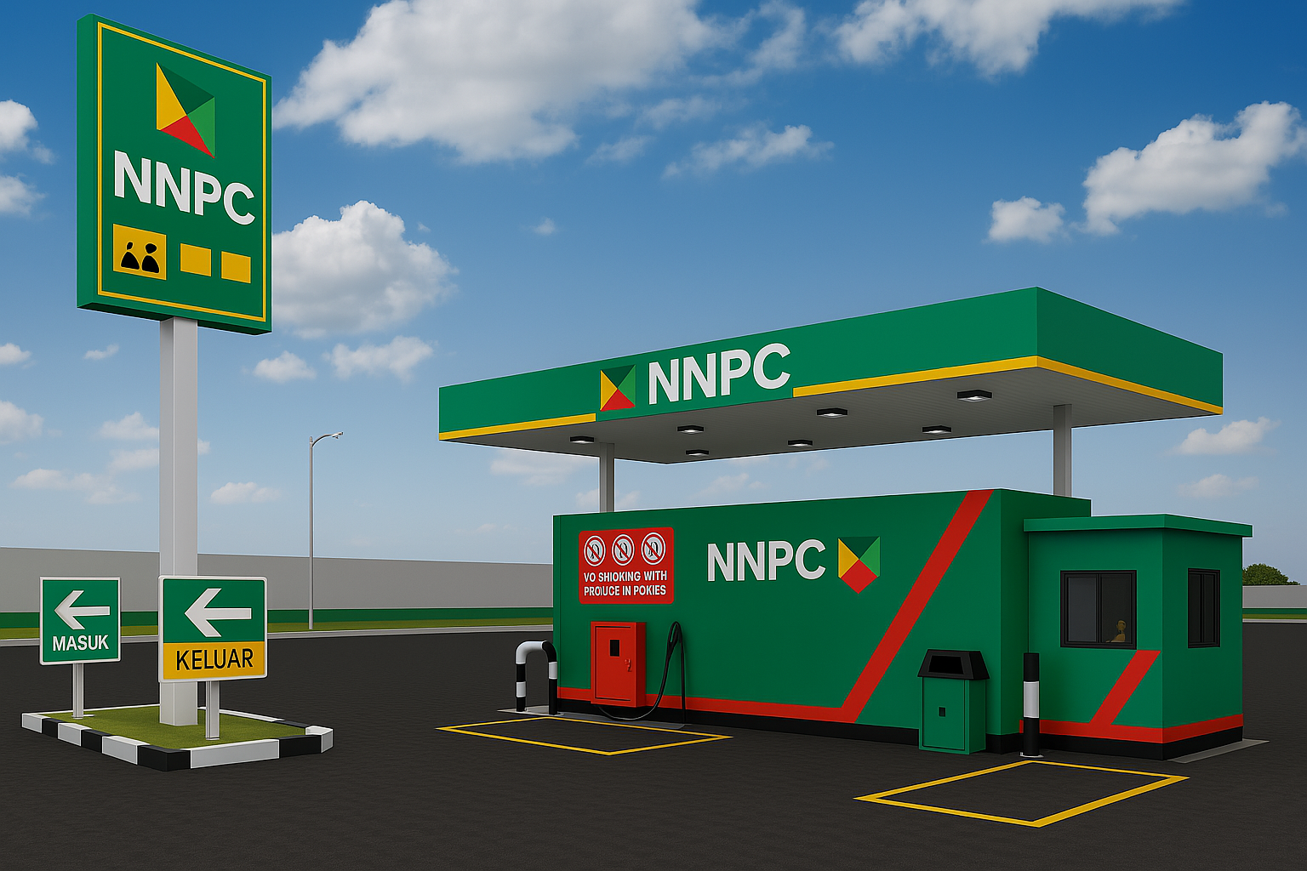
PROPOSED STATION MODEL DESIGN 1B

Slide 12
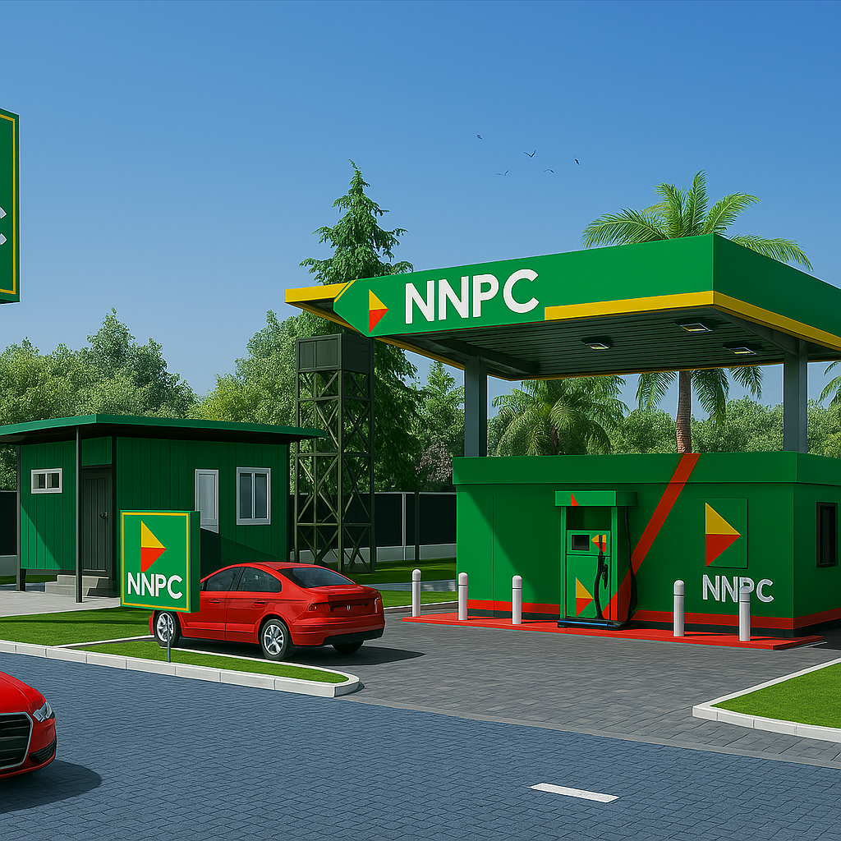
PROPOSED STATION MODEL DESIGN 1C

Slide 13
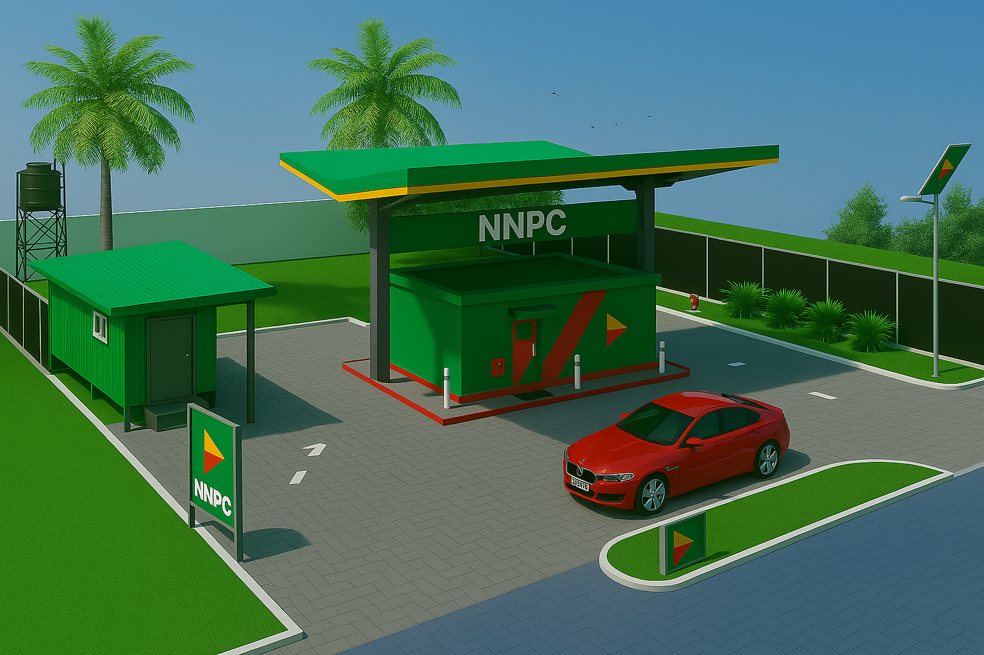
PROPOSED STATION MODEL DESIGN 2A

Slide 14
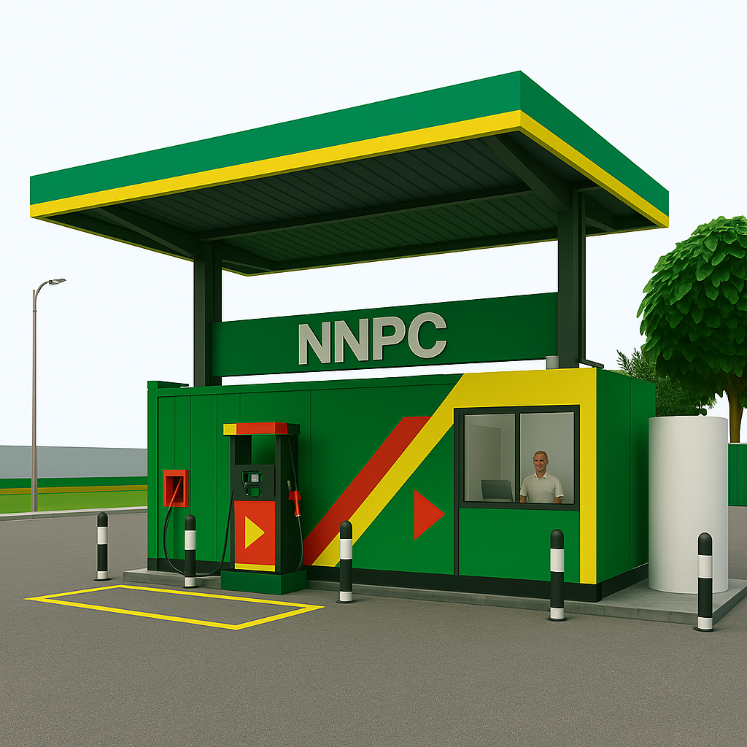
PROPOSED STATION MODEL DESIGN 2B

Slide 15
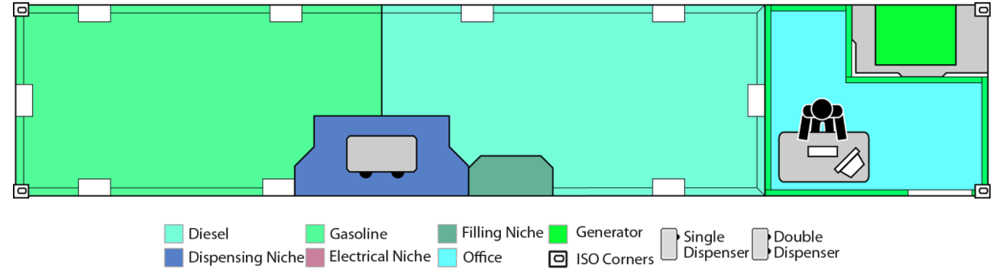
TANK FEATURES & LAYOUT
SMC40-1TO
ISO 40 ft including CSC plate
Double Product Holding Tanks
20,000 liters capacity per tank
Attached generator set + Exterior Panels (Optional)
Double walled (6 mm inside layer + 4 mm outside layer)
B.I.C - Certified by Bureau International des Containers.

Slide 16
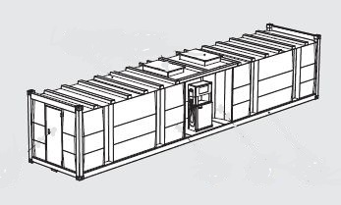
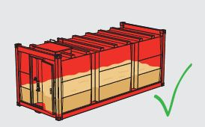
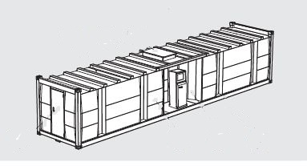

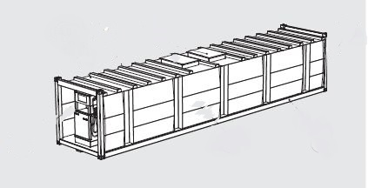
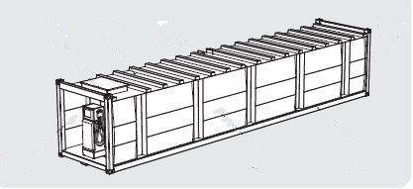
STORAGE TANK FEATURES
Optimum Capacity
Side Dispenser Design
Front Dispenser Design

Slide 17
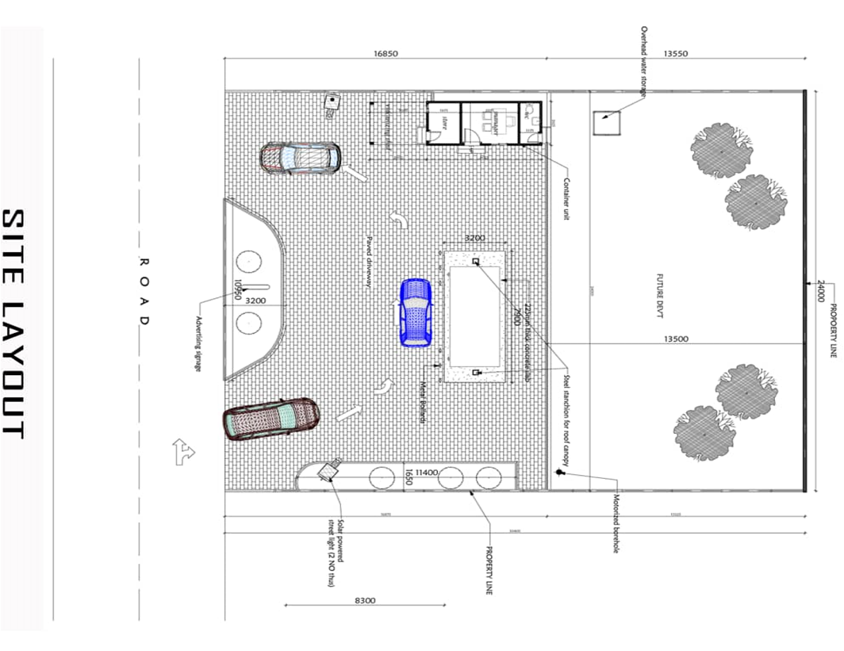
GENERAL STATION LAYOUT

Slide 18
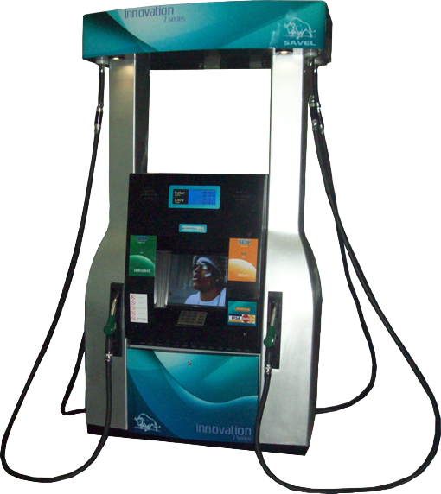
AUTOMATED DISPENSER FEATURES
The 6 & 7 Series is a premium segment fuel pump developed for high-volume stations. It stands out with its filling speed of up to 130 liters per minute and multiple payment system integration.
Spot
4 spotlights that make the columns stand out.
3D Kolon
3D designed columns. Completely unique and aesthetic.

Slide 19
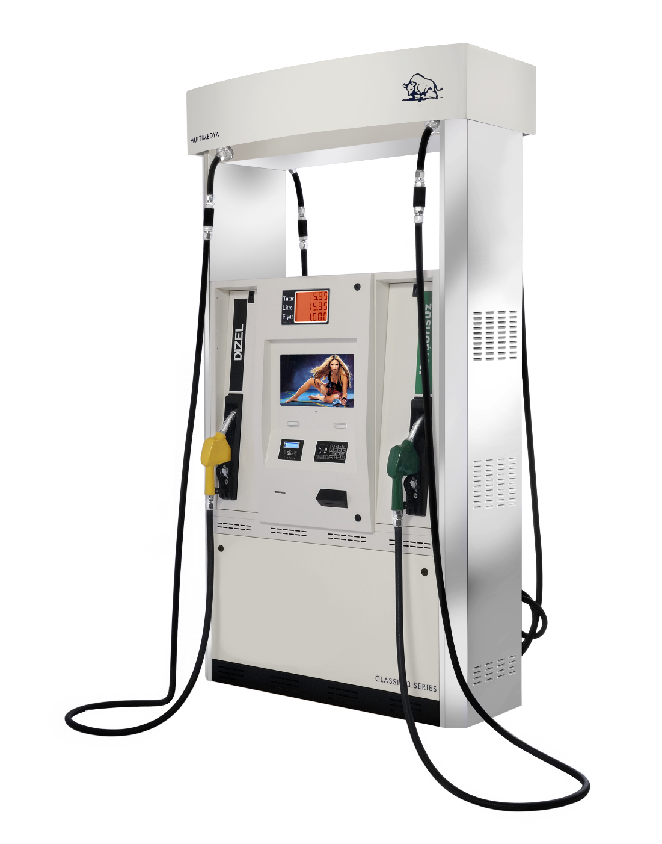
AUTOMATED DISPENSER FEATURES
Monitor & Keypad
19” LCD that can be used interactively. Full compatibility with the new multimedia world. ATM type keypad. Embedded design and clear display
POS Integration
Credit card, Fuel card, Mobile Money usage option Fast data flow with RFID technology. Direct internet connection Unit price and data display in Deepened front panel with New meter technology for Perfect visibility.

Slide 20
COST ANALYSIS
CONVENTIONAL FUEL STATION | OUR SOLUTION
Generally, costs up to $500,000 to set up quality stations exclusive of location set up costs | Total investment at around $XXXXXXXX.
Requires a large size of land to build on and MUST be in highly visible and high vehicular traffic area. | Can be relocated for maximum optimization as it requires just enough space to set up and for cars to drive through to be served.
Period estimated for Return on Investment is 5 to 15 years. | ROI period is 3-5 years maximum and can be lower based on turnover of site.

Slide 21
CONCLUSION
The future and success of the fuel retail industry is based on technology solutions like ours that will help reduce cost, drive sales and increase revenue and make the African market relevant.
We look forward to further steps towards the bright future.
You can always reach us for additional information via
Tel.
Email:
Web link:
Thank you for you attention.

